Slide 1

Evidence-based active learning approaches in introductory statistics classes
Craig Alexander (University of Glasgow)

Slide 2
Level 1 Statistics - Background
School of Mathematics and Statistics, University of Glasgow.
Level 1 Statistics courses – Statistics 1Y & Statistics 1Z
Typically taken in year 1 or 2 (of 4-year degree).
~280 students.
Active learning introduced into these courses in 2020-21.
Teaching consists of:
3 weekly lectures, weekly tutorials & fortnightly labs
Assessment:
10 weekly quizzes (2% each), 4 lab group tasks (1.25%) each. Final online exam (75%)

Slide 3
Flipped learning
“Less ‘sit and listen’, more ‘do and learn’”.
Benefits include:
Students can learn at their own pace.
More efficient as students enter the lecture room prepared.
Makes lectures more enjoyable, productive and engaging.
Doing exercises in class allows students to help each other.

Slide 4

Flipped learning
Pre-lecture reading and quiz to introduce topics to students.
Focus on active learning in lectures motivated by interesting examples.
Lots of activities for students to work on themselves or in groups during each lecture with answers submitted via polling software.
Making use of learning spaces in James McCune Smith Learning Hub.

Slide 5
Flipped learning
Does it work…?
It relies on preparation and trust.
Early indications suggested many students weren’t completing the pre-lecture material.
Project to investigate engagement in active learning began in 2023-24, with Dr. Eilidh Jack, Dr. Mitchum Bock (University of Glasgow) and Prof. Elinor Jones (University College London).

Slide 6
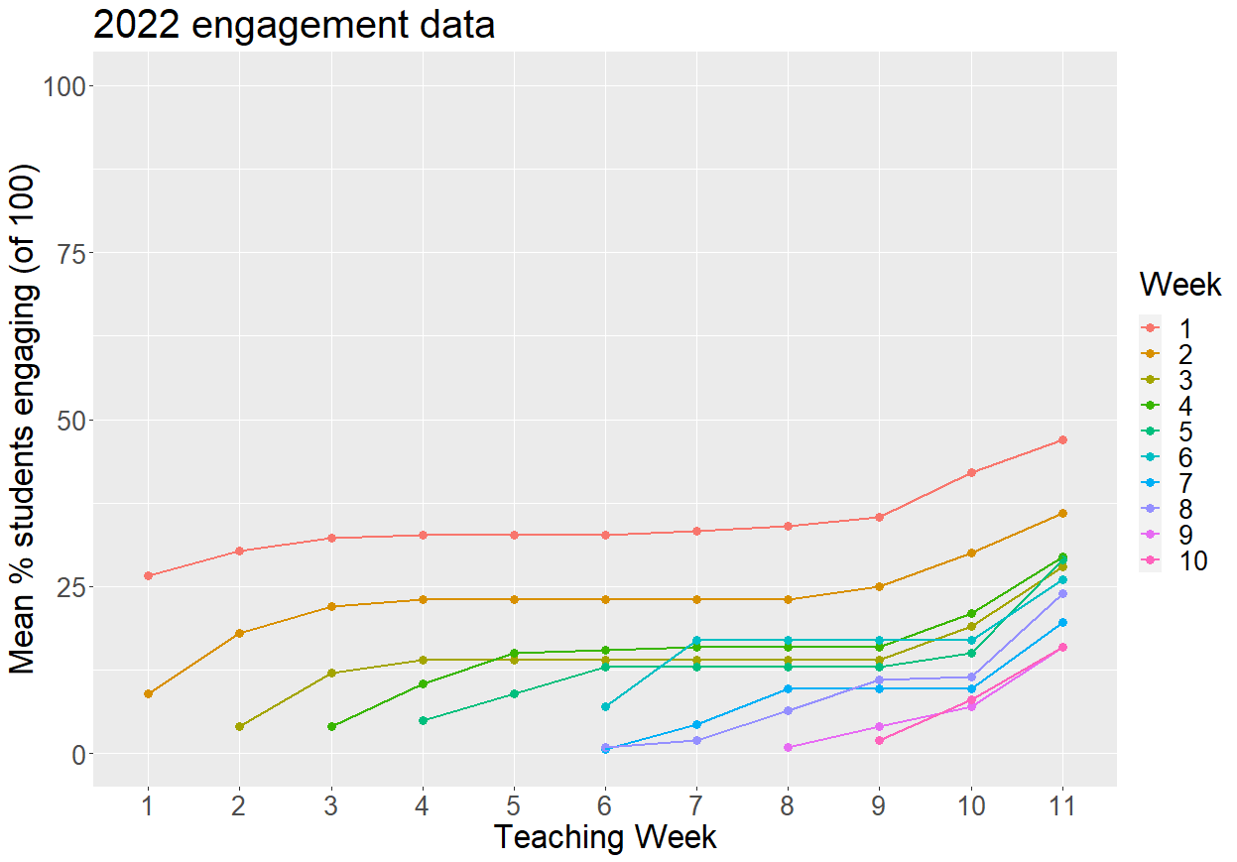
Evidence: 2022 engagement data
Caveat: this only shows data for students who provided consent to participate in our ethically approved study (100 of 257 students).

Slide 7
Why did it go wrong?
Student comments like “Slides could provide general notes before worked examples”.
Our approach needs to be tweaked:
Too much volume of work. Can we make the pre-lecture material less burdensome?
Students find it difficult to motivate themselves: fixed deadline for getting work done (requires time management skills), vs. a lecture where there is a fixed timeslot dedicated to learning.
Not enough positive reinforcement for students who are completing activities.
Can we reward engagement with pre-lecture material?

Slide 8
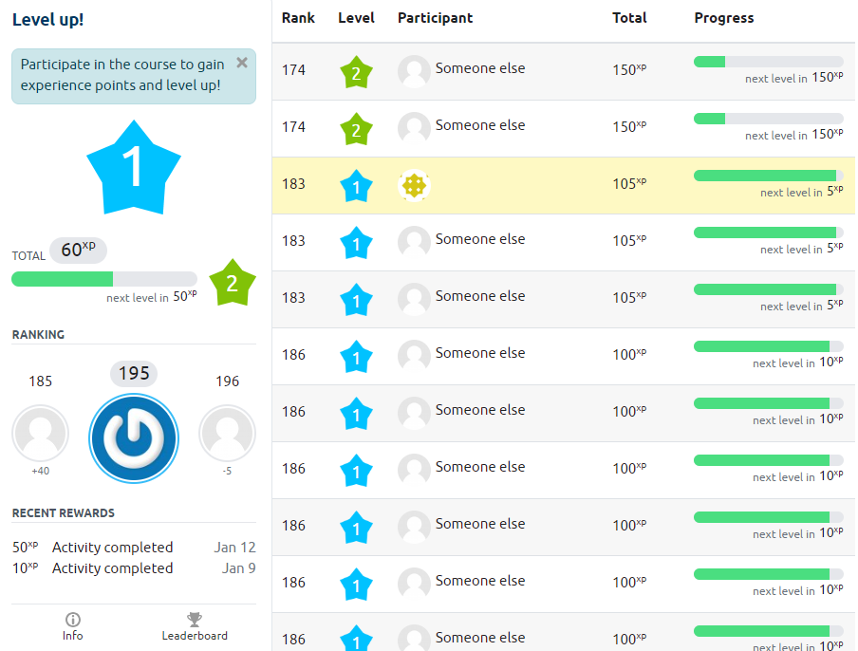
Level up!
Participate in the course to gain experience points (xp) and level up!
Points are awarded for participation in course via Moodle.
Course lecturer creates rules for when/how many points should be awarded.
To tackle engagement in pre-lecture activities, full points were only awarded if the activity was completed before the associated lecture with half-points awarded thereafter.
Endeavour based not merit based.
Prizes awarded at end of course.

Slide 9
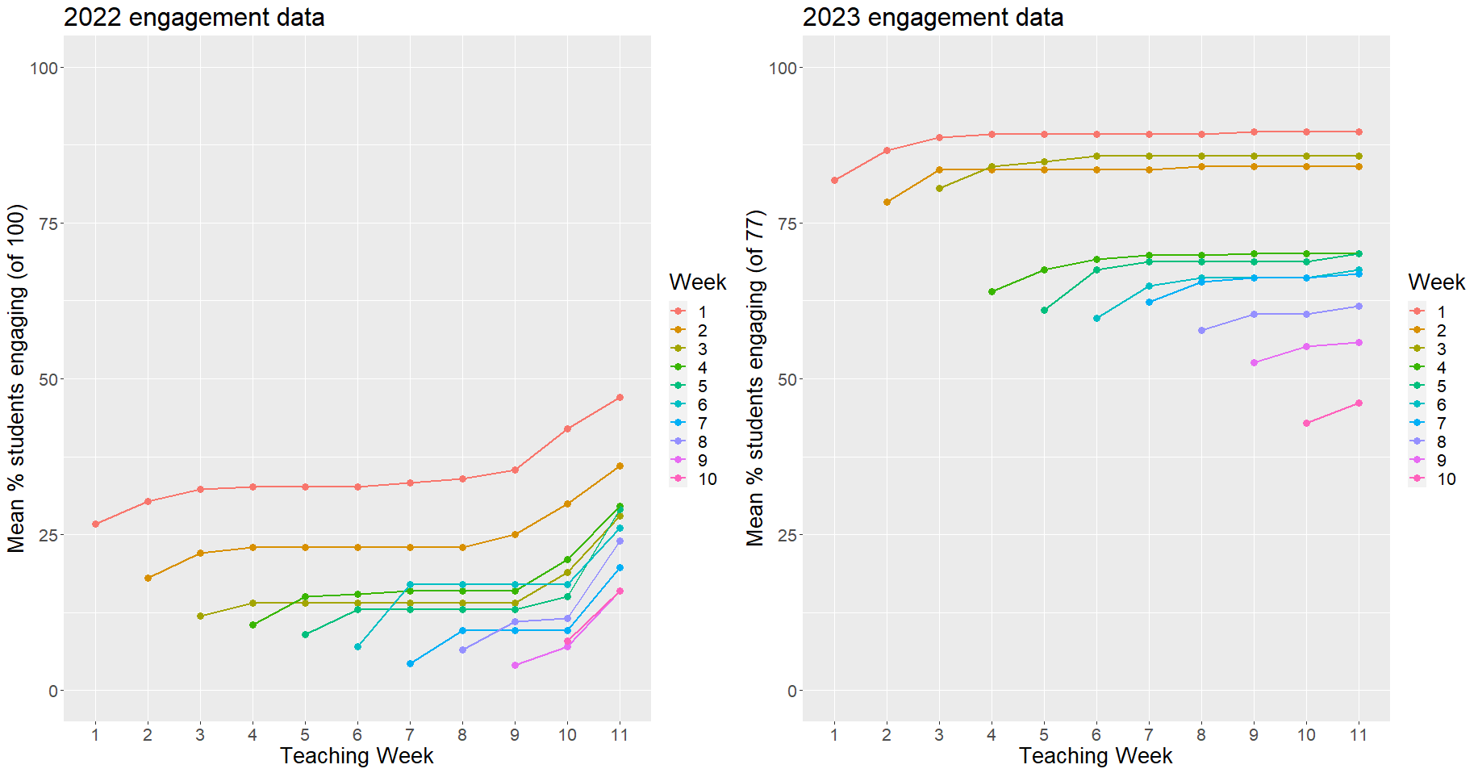
Evidence: Engagement data
Caveat: this only shows data for students who provided consent to participate in our ethically approved study (100 of 257 students in 2022 and 77 of 260 students in 2023).

Slide 10
Level up! Reflections so far
Interaction has been better than expected.
Informal feedback: 61% of students say “Level-up makes me more likely to engage in the course”.
Average activity completion increased by 45% from 2022-23 to 2023-24. Similar trends shown semester 1 2024-25.
May have contributed to increase in performance with 82% of students receiving a grade of A, B or C compared to 60% in 2022-23. This again improved to 88% in 2024-25.

Slide 11
Conclusion
Flipped can work but needs considered implementation.
Looking at data collected on VLEs can help to give an overall picture of student engagement in real-time.
Overburdening students, or when motivation is lacking, can be disastrous (especially for younger students), but careful scaffolding can help.
Introducing a gamification element can help boost motivation and engagement.
Think broader than your module: think across a programme.
Who are your students, and what support do they need?
Flipped learning puts a lot of learning burden on students. Too much might mean reduced engagement.
Tie in the flipped learning with what happens in class (if you say that you won’t go over the flipped learning material in class, then don’t!).
Also helpful to show engagement stats to students in each class!

Slide 12
Thanks for listening!
Jack, E. , Alexander, C. and Jones, E. M. (2024) Exploring the impact of gamification on engagement in a statistics classroom. Teaching Mathematics and its Applications: An International Journal of the IMA

Slide 13

UKCOTS 25
UKCOTS 25 will be held at the University of Glasgow on 24th – 25th June 2025.
Call for abstracts extended to 21st February.
Find out more at ukcots.org and join the mailing list.

